Slide 1
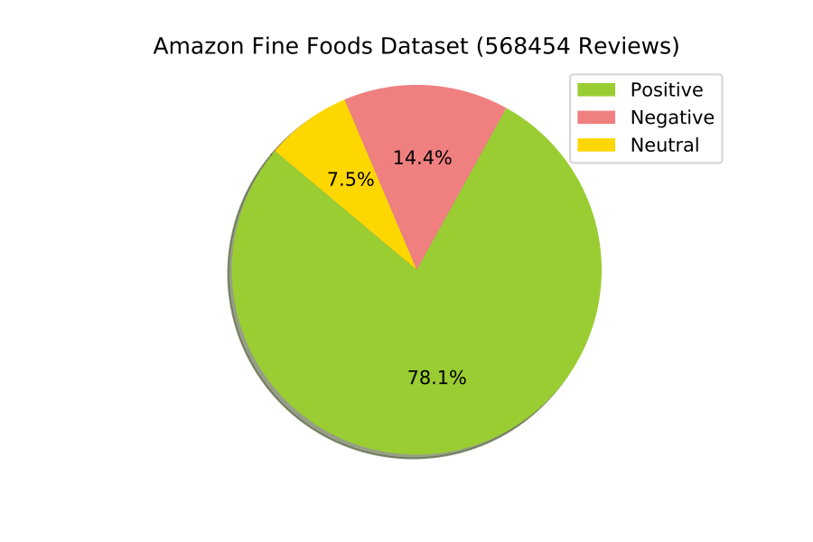
NIELIT SUMMER TRAINING 2021
COURSE:
BIG DATA ANALYTICS
SUBMITTED BY:
VANSHIKA DHARWAL
GIRISH
PROJECT NAME:
CUSTOMER BEHAVIOUR PREDICTIONS

Slide 2
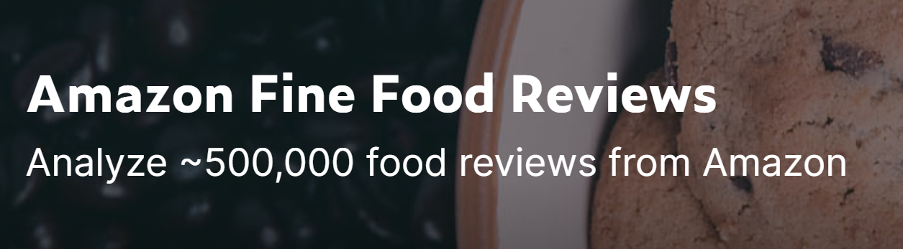
AIM - The goal of our study was to analyse the Amazon Fine Food Reviews using python.
DESCRIPTION
Nowadays companies want to understand, what users and the general public think about their latest features or products. Quantifying users content, idea, belief, and opinion is known as sentiment analysis. This is usually used on social media posts and customer reviews in order to automatically understand if some users are positive or negative and why.

Slide 3
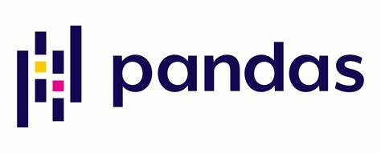

TOOLS
Important libraries used:
Pandas: A python library used for faster data analysis, data cleaning and data pre-processing
NLTK: The most famous python module for NLP techniques

Slide 4
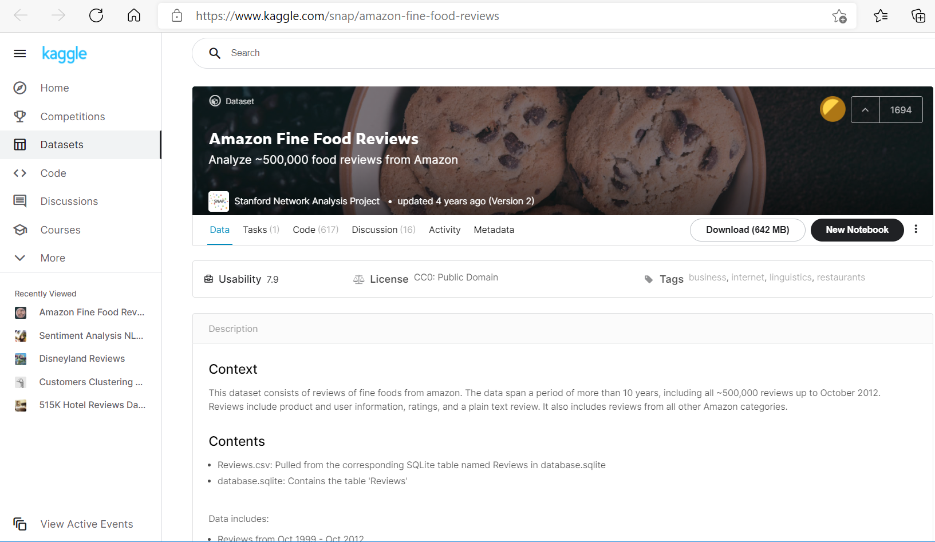
DATASET USED

Slide 5
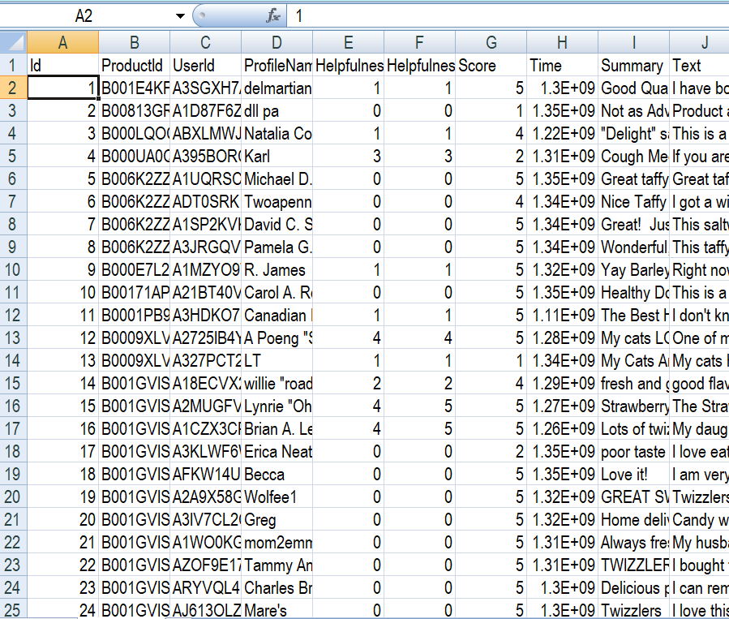
Load data df=pd.read_csv(r'D:\Reviews.csv') Explore the Data df.head(), df.shape, df.info() Text Preprocessing df['Text'] = df['Text'].apply(lambda x: " ".join(x.lower() for x in x.split())) df['Text'] = df['Text'].str.replace('[^\w\s\d]', "") Removal of Stop Words: lambda x:(x for x in x.split() if x not in stop) Lemmatization: .lemmatize()
PROCEDURE

Slide 6
Data Visualization

Slide 7
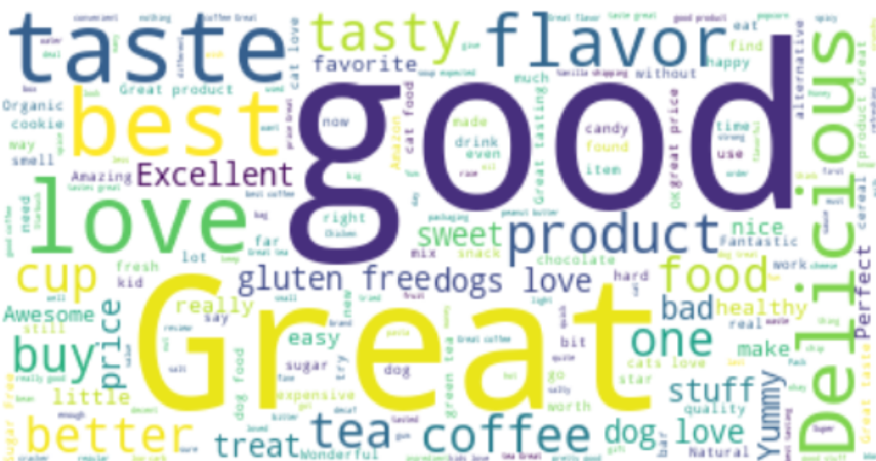
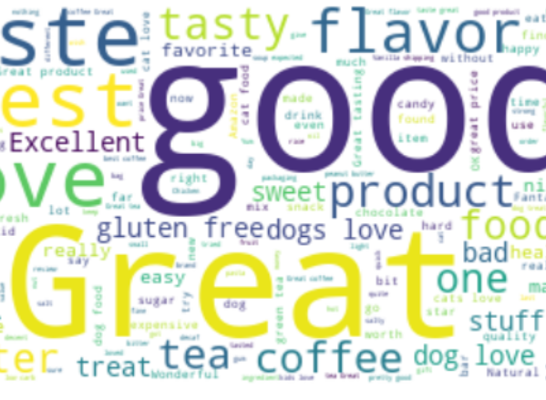
Word Frequency of Summary of the reviews
Concatenated all Summaries into a single string.
Analysed the most frquent words using a simple word cloud.

Slide 8
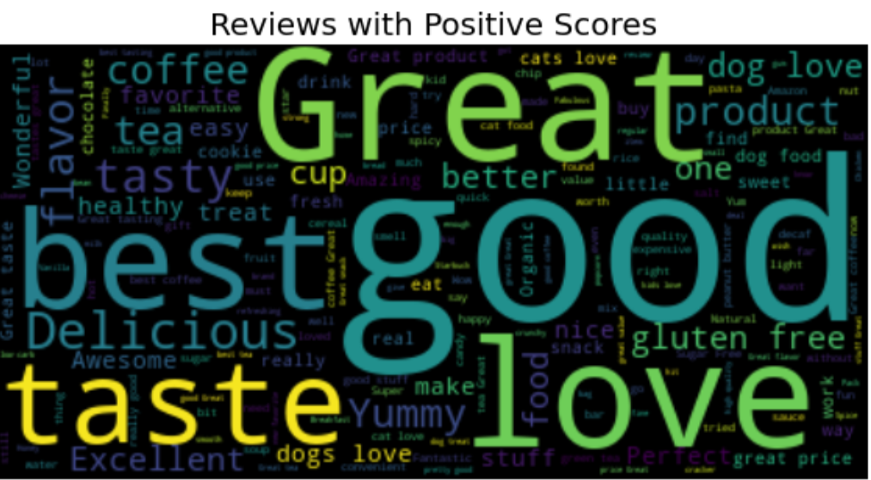
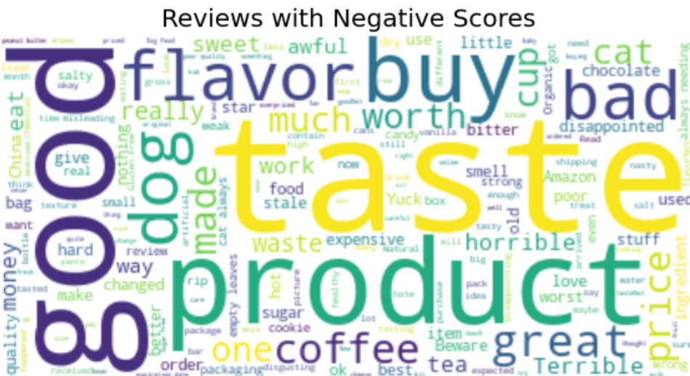
Analysed the Positive and Negative reviews

Slide 9
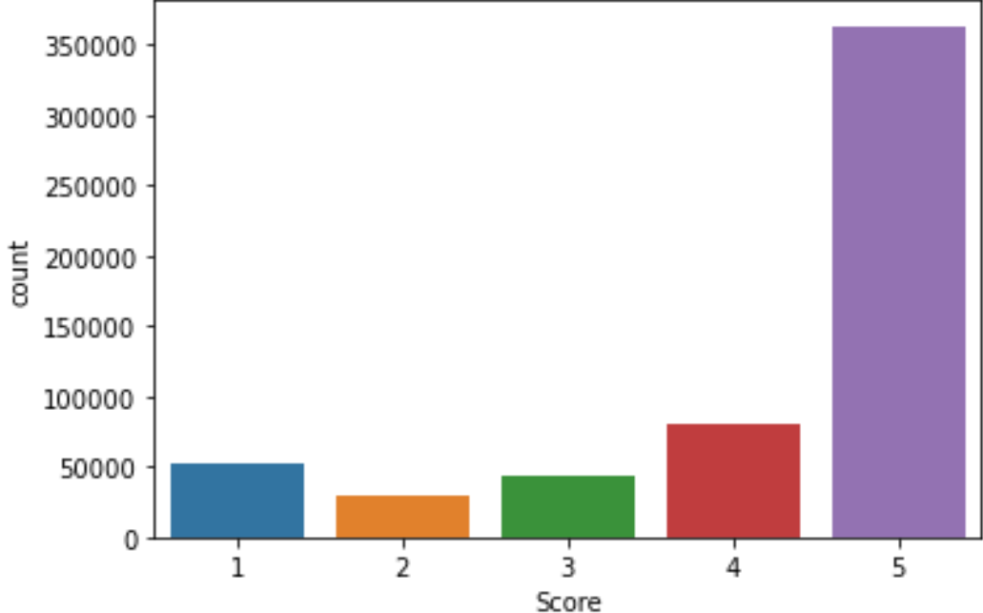
Analysing the overall Ratings
From graph bellow it is clear that the products are given more positive ratings ie, around 350000 reviews are in category 5.

Slide 10
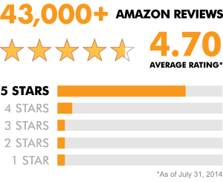
CONCLUSION
From this analysis we can conclude that the products of Amazon fine food are liked and appreciated by most of the customers.

Slide 11
PROJECT FILES
CODE:
JUPYTER NOTEBOOK:
https://github.com/vanshika89/Customer-Behaviour-Analysis/blob/main/Customer%20Behaviour%20Predictions.ipynb
DATA SET:
https://www.kaggle.com/snap/amazon-fine-food-reviews

Slide 12

Thank You

